Slide 1

Section 1
CSE/STAT 416

Slide 2
Agenda
Review Overfitting & Bias-Variance Tradeoff
Review Regularization with Ridge and Lasso
Ed Notebook
Standard Scalar (documentation)
Ridge, Lasso code (documentation)
Notes:
Review Ridge, Lasso regularization

Slide 3
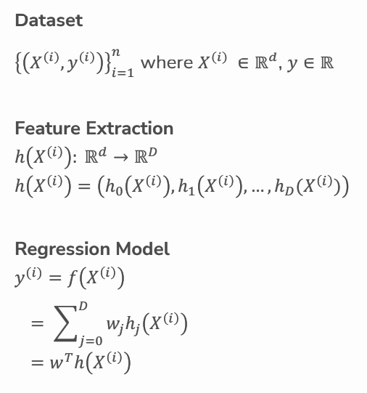
Linear Regression Model
Notes:
Feature extraction - the process of turning data into features
reduction of the number of features
transforming each data attribute
Regression model - weighted sum of features

Slide 4
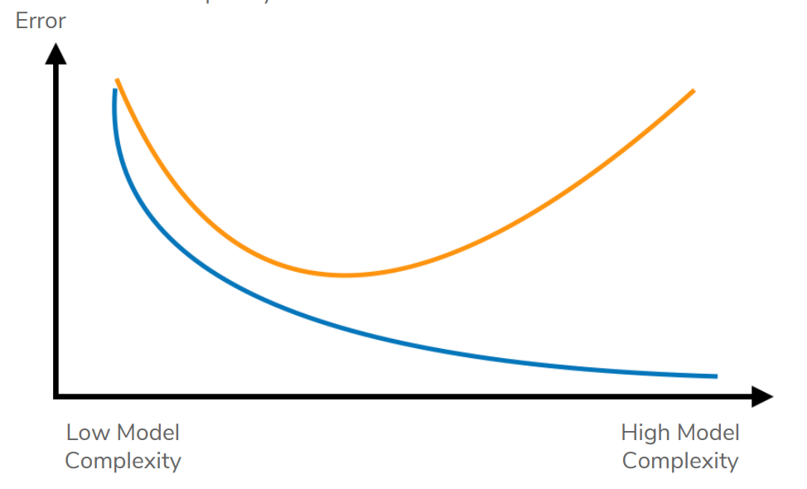
Overfitting, Underfitting: Train/Test Error
True Error
Train Error
Overfitting happens when we too closely match the training data and fail to generalize.
We use test error to estimate true error.
[Question]: On the plot above, can you find the places where underfitting and overfitting occur, respectively?
Notes:
Reminder: Overfitting happens when we too closely match the training data and fail to generalize. Underfitting is when the model is too simple and fail to capture the important the relationship between the features and the target variable.
We find that the more complex a model is the easier a model will overfit, and the less complex a model is the easier a model will underfit
Overfitting - High true error (validation or test error?) and low train error
Underfitting - High true error and high test error
Sweet spot - Low true error and low test error
Trains well and generalizes well

Slide 5
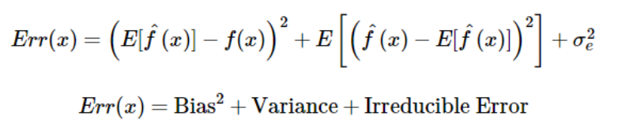
Bias-Variance Tradeoff
Overfitting and underfitting are the result of two types of error: bias and variance
Bias: —
Variance: —
Simple models: — bias + — variance
Complex models: — bias + — variance
Notes:
Result of the bias-variance trade-off
Error of the model is made up of 3 things: bias, variance and irreducible error
Bias - difference between the true model and the average predictor / difference between the average prediction of our
model and the expected value which we are trying to predict
Variance - how much the predictions will change if a different training dataset is used
Simple models: High bias + Low variance
Complex models: Low bias + High variance

Slide 6
Bias-Variance Tradeoff
Overfitting and underfitting are the result of two types of error: bias and variance
Bias:
difference between true function f(x) and “average” predictor
Variance:
variability of model prediction for a given data point
Simple models: High bias + Low variance
Complex models: Low bias + High variance
Notes:
Result of the bias-variance trade-off
Error of the model is made up of 3 things: bias, variance and irreducible error
Bias - difference between the true model and the average predictor / difference between the average prediction of our
model and the expected value which we are trying to predict
Variance - how much the predictions will change if a different training dataset is used
Simple models: High bias + Low variance
Complex models: Low bias + High variance

Slide 7
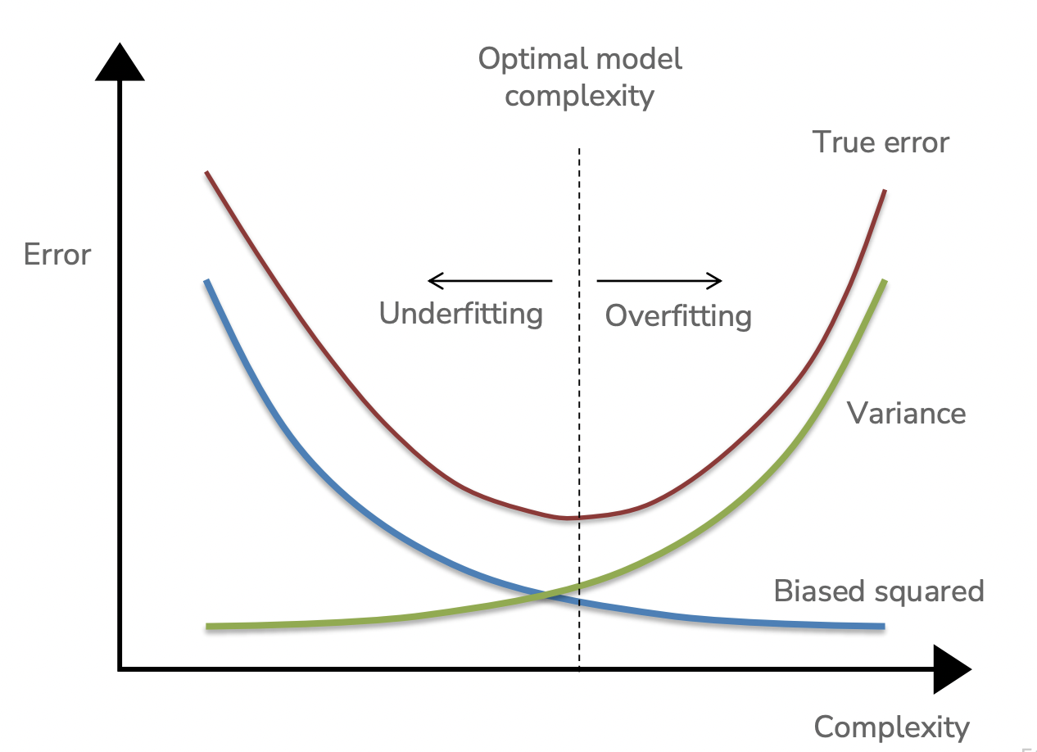
Bias-Variance Tradeoff
Notes:
Point underfitting/overfitting positions on the left plot
Underfitting: when using low-complexity model => high bias+low variance
Overfitting: when using high-complexity model => low bias+high variance
Sweet spot - low variance and low bias

Slide 8
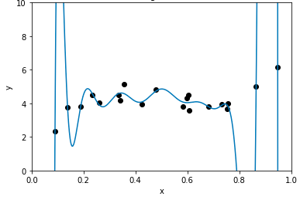
Regularization
Model self-regulates to prevent overfitting
Ensures coefficients are not “too large”
Notes:
Remember: we’ve observed that models that have large coefficient magnitudes also have high complexity
Regularization: a model that prevents overfitting by restricting how large our coefficients of our model can get

Slide 9
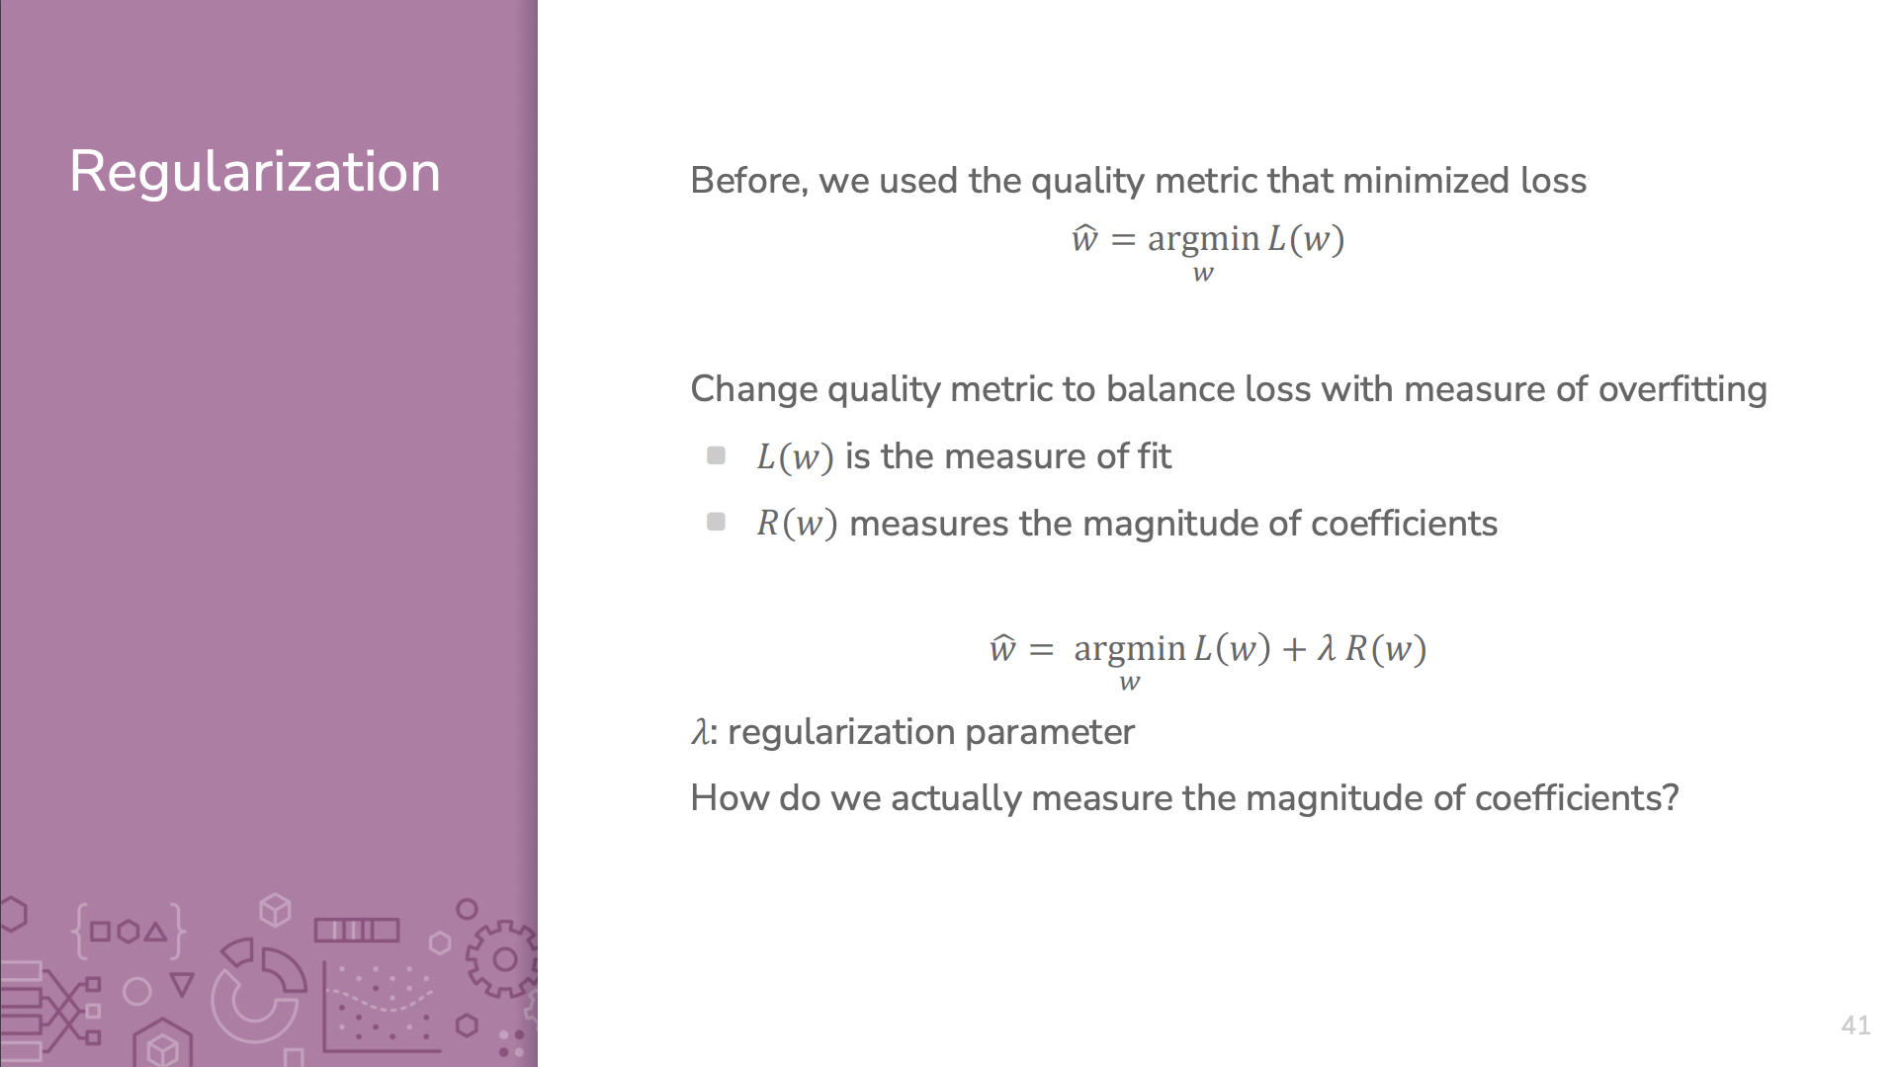
Notes:
λ - regularization coefficient (control the amount of regularization)
R(w) - magnitude of coefficients
L(w) = measure of model fit
[POP-QUIZ]
How do we actually measure the magnitude of coefficients?

Slide 10
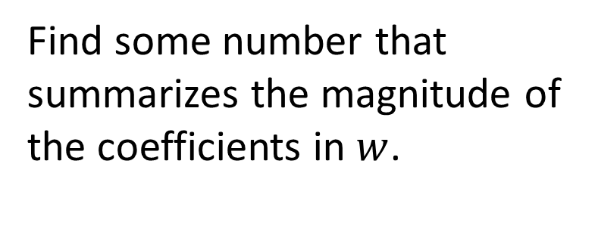
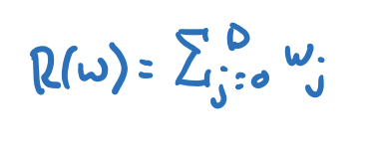
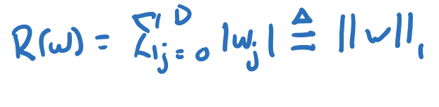
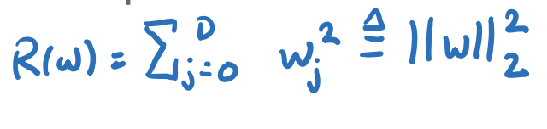
Regularization
Sum?
Sum of absolute values?
Sum of squares?
Notes:
So there a few different ways to regularize,
the 1) way we talked about was the sum of the coefficients but we what we learned might be wrong with that is that say you have a really large positive coefficient and a really big negative coefficient, when you add those together we get a small sum so this isn’t a really good regularization technique
this leads us to the two other techniques we talked about in class
pop quiz: what type of norm is this and what regression uses this definition of the regularization aspect?
the sum of absolute values also known as the L1 norm which we use in LASSO regularization and the sum of squares also known as the L2 norm used in Ridge Regularization

Slide 11
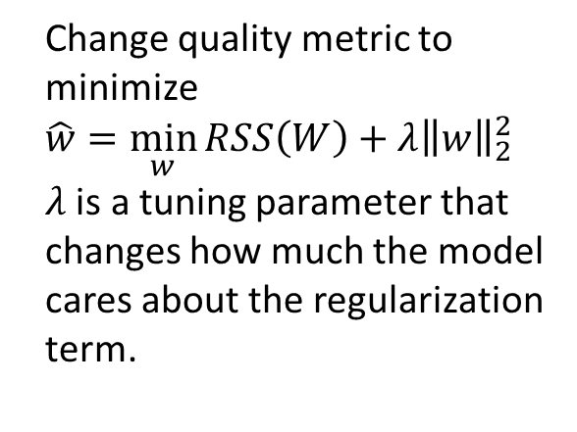

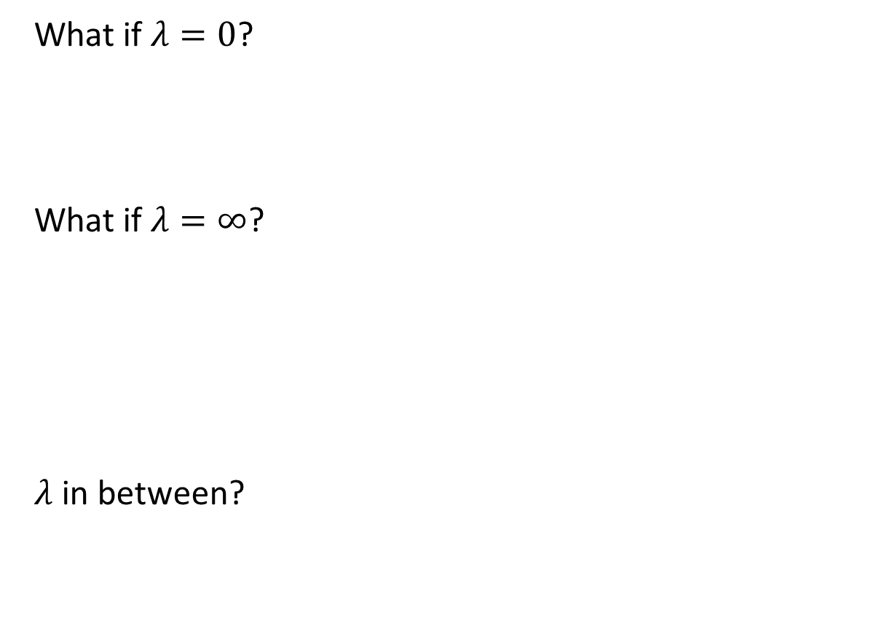


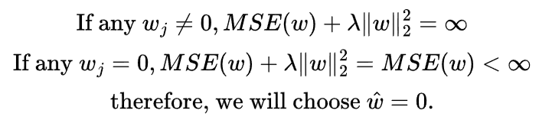

Ridge Regression
Notes:
So in Ridge regression
using the L2-norm as the measure of magnitude of coefficients
when lambda = 0, our model will just be the regular regression model with the quality metric being only MSE
when lambda = infinity, there are 2 cases
if any weight is not 0, then the quality metric calculation will result to infinity
if all weights are 0, then the quality metric will result to just MSE, which is a definite value
it’s impossible to get an indefinite value for a quality metric, so the only possible case is when all weights are 0
so when we increase lambda, we are essentially penalizing the weights more
so our lambda must be in between 0 and the minimized RSS values

Slide 12
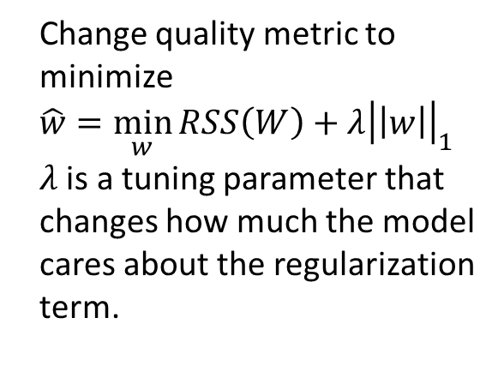
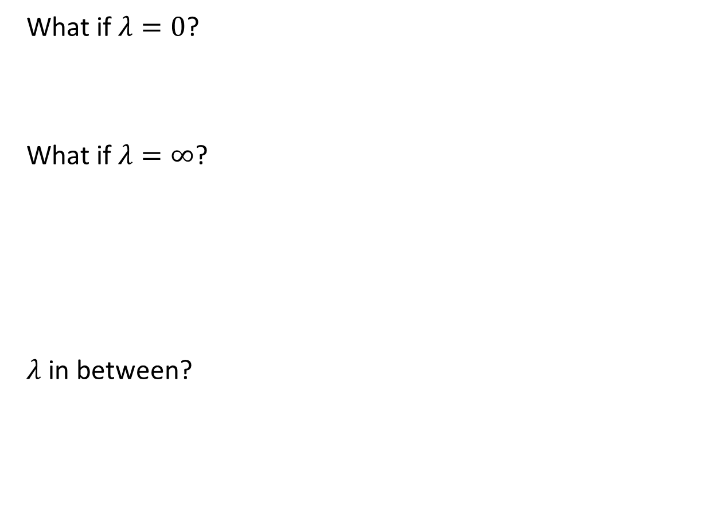


Lasso
Notes:
same thing as Ridge but we are using the L1 norm which is the absolute sum
so again we get the same weights with lambda equalling 0 and infinity as in Ridge

Slide 13
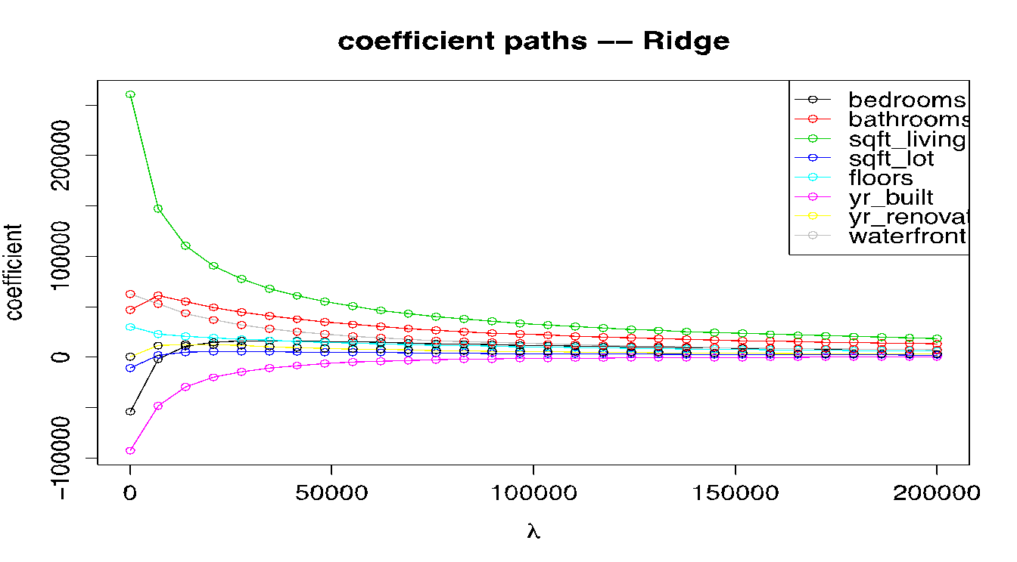
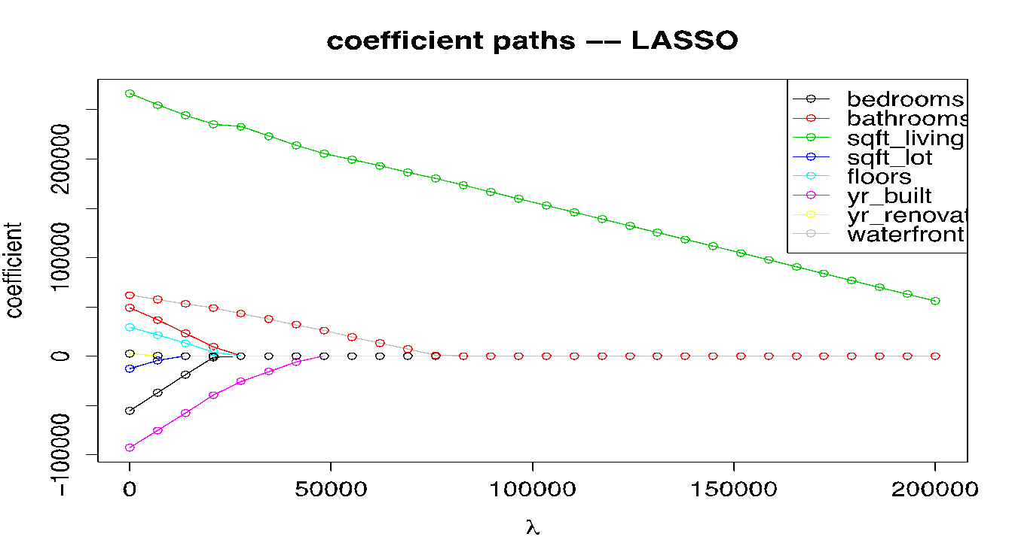
Comparison
Ridge Coefficient Paths
Reduces magnitude of coefficients
Lasso Coefficient Paths
Removal of unhelpful features
Notes:
Intuitive difference is that Ridge Regression is used to reduce the magnitude of coefficients while LASSO Regression is used to remove useless features that don’t help us establish the relationship between input and output
More mathematical difference:
When using gradient descent to find the optimal set of weights, you’re trying to take the most steep gradient. With a flatter gradient, you’ll take a smaller step, and with a more steep gradient, you’ll take a larger step.
Looking at the shape of the 2 norms
Ridge: continue to try to move the weight to 0, but we take smaller steps as a weight approaches 0 because the gradient of the loss function is getting more flat. Thus, it’s much less likely for the weights to reach 0 with an L2 norm
Lasso: The gradient is either -1 or 1, which means Lasso regression will move the weight to 0 with the same step size and can get to 0 more likely.

Slide 14
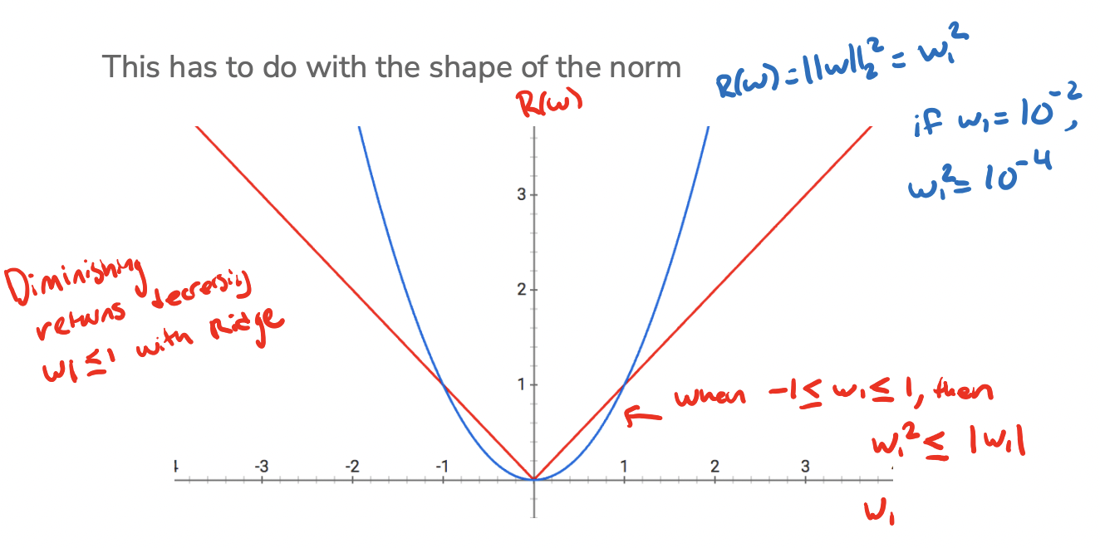
L1 Norm vs. L2 Norm (visual)
Notes:
More mathematical difference:
When using gradient descent to find the optimal set of weights, you’re trying to take the most steep gradient. With a flatter gradient, you’ll take a smaller step, and with a more steep gradient, you’ll take a larger step.
Looking at the shape of the 2 norms
Ridge: continue to try to move the weight to 0, but we take smaller steps as a weight approaches 0 because the gradient of the loss function is getting more flat. Thus, it’s much less likely for the weights to reach 0 with an L2 norm
Lasso: The gradient is either -1 or 1, which means Lasso regression will move the weight to 0 with the same step size and can get to 0 more likely.

Slide 15
Hyperparameters
How to tune hyperparameters?
for each setting of HPs:
train model with current HP
validate predictor (cross validation/validation set)
track HPs with lowest validation error
return best HP and estimate of test error
Notes:
Can you describe the algorithm?
How do we choose the right value of 𝜆? We want the one that will do best on future data. This means we want to minimize error on the validation set.
you will initialize with your hyperparameter values and train your model with that HP
generate prediction using the validation set and calculate the validation error
save the hyperparameter with the lowest validation error
at the end return the best hyperparameter and apply the model with that hyperparameter on the test set to get test error

Slide 16
Ed
Programming Portion (follow along!)
Webpage

Slide 17
Closing Thoughts
Let me know if you have…
Questions (content or otherwise)
Feedback on how section is run (give feedback to your section TAs)
Cool ML research/applications you want to share (maybe we could incorporate it into the lesson plan!)

